Slide 1
Adult social care ratings summary
Current ratings published up to 5 December 2017
National Reporting Team

Slide 2
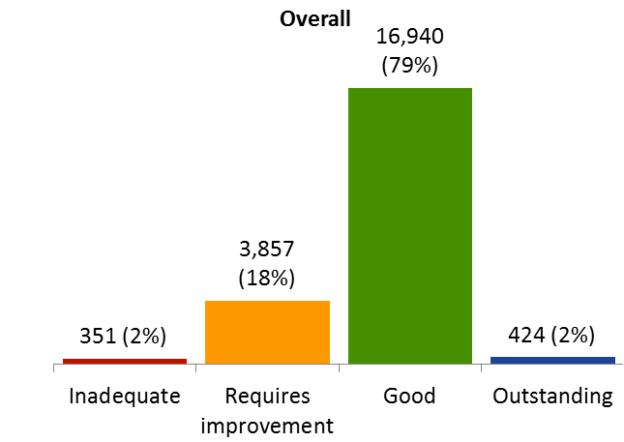
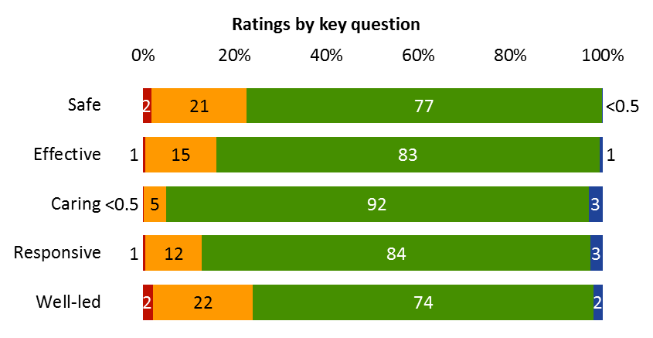
Current ratings overall and by key question for active locations
Note: Figures in chart are percentages
Source: CQC ratings data, data extracted 05/12/2017

Slide 3
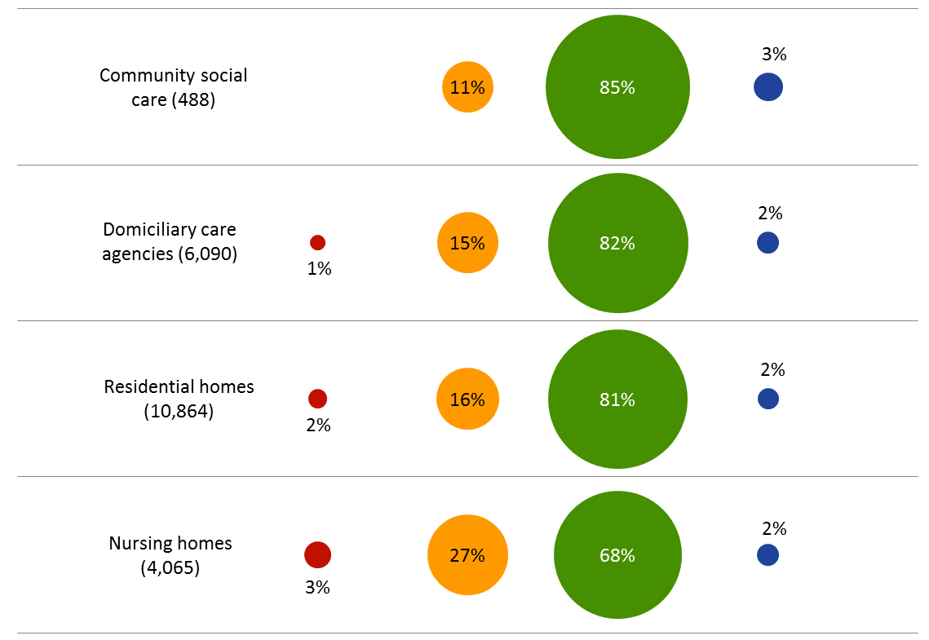
Current overall ratings by service type
Please note:
figures in brackets are the number of active locations rated
In previous updates, locations that were registered as both domiciliary care agencies and community social care were included under both types of service. Now, domiciliary care agencies continue to include any location which is registered as providing this service but community social care now only includes locations which provide other types of community social care.
Source: CQC ratings data, data extracted 05/12/2017

Slide 4
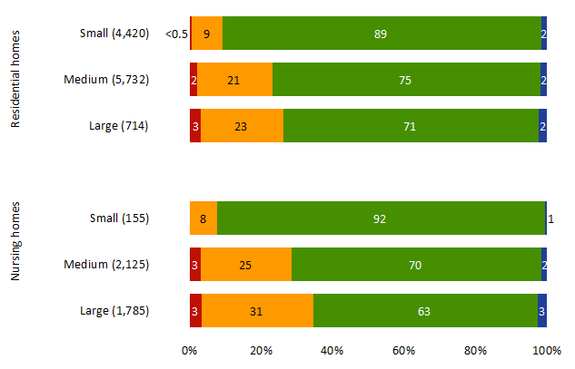
Current overall ratings by size of care home
Small = 1-10 beds, Medium = 11-49, Large = 50+
Source: CQC ratings data, data extracted 05/12/2017

Slide 5
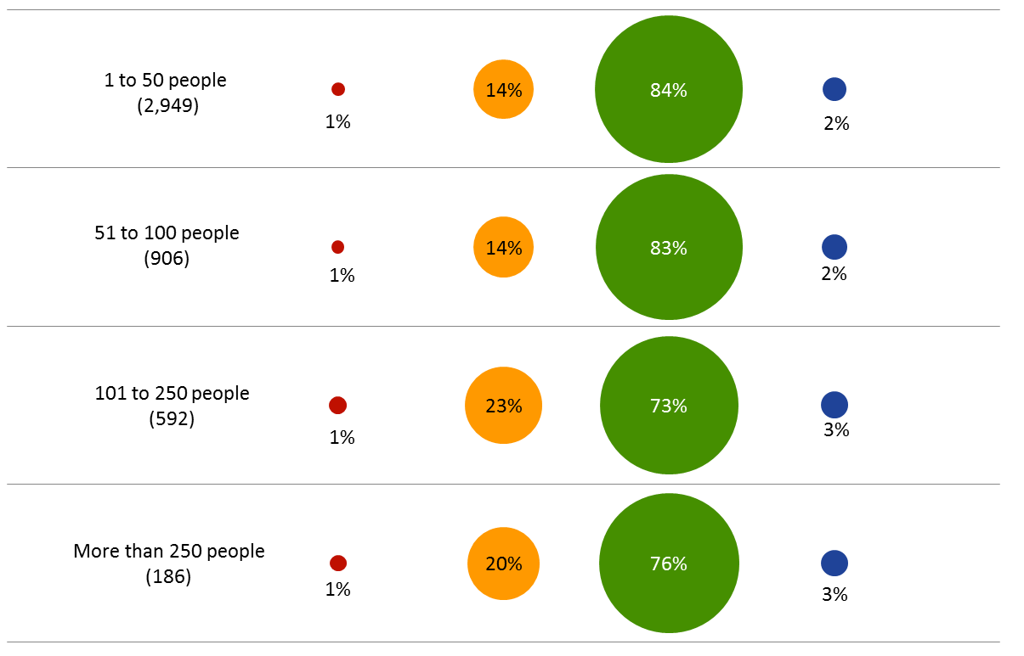
Current overall ratings by size of domiciliary care agency
The above chart presents data we have for DCA locations that have been rated and the number of people using the service. There is a trend suggesting that locations providing care to a smaller number of people are performing better than larger services. This analysis is based upon 4,633 rated DCA locations.
Source: CQC ratings data extracted 05/12/2017 and CQC community PIR data from 05/12/2017

Slide 6
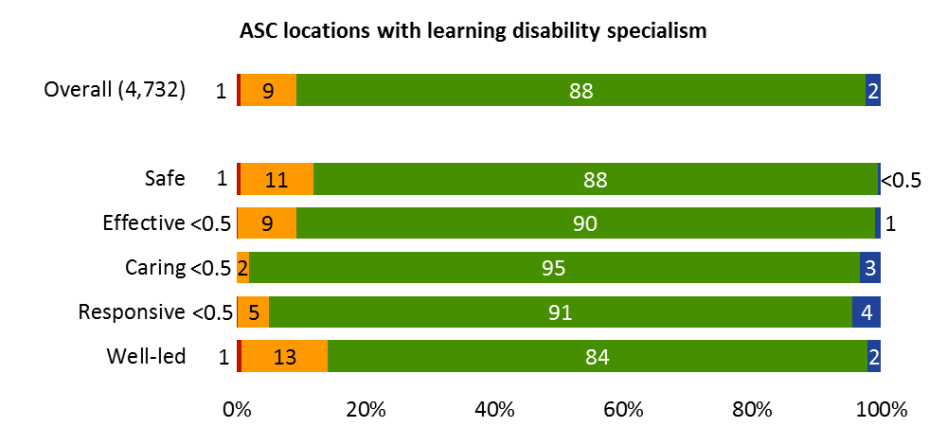
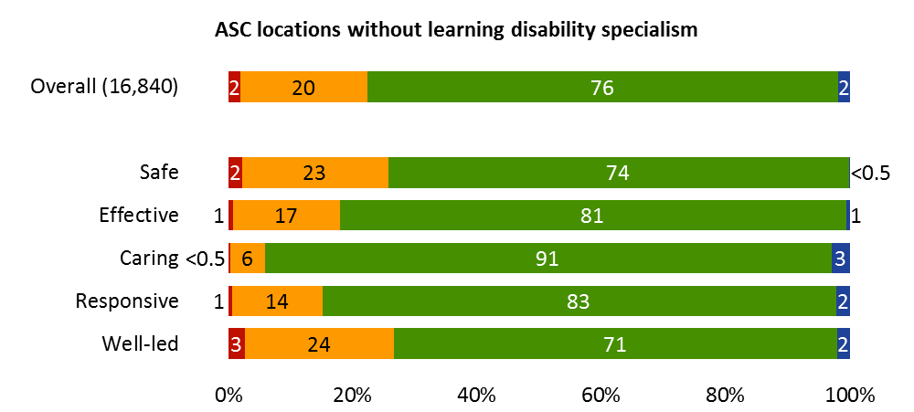
Current overall ratings for services with and without learning disability specialism
Source: CQC ratings data, data extracted 05/12/2017

Slide 7
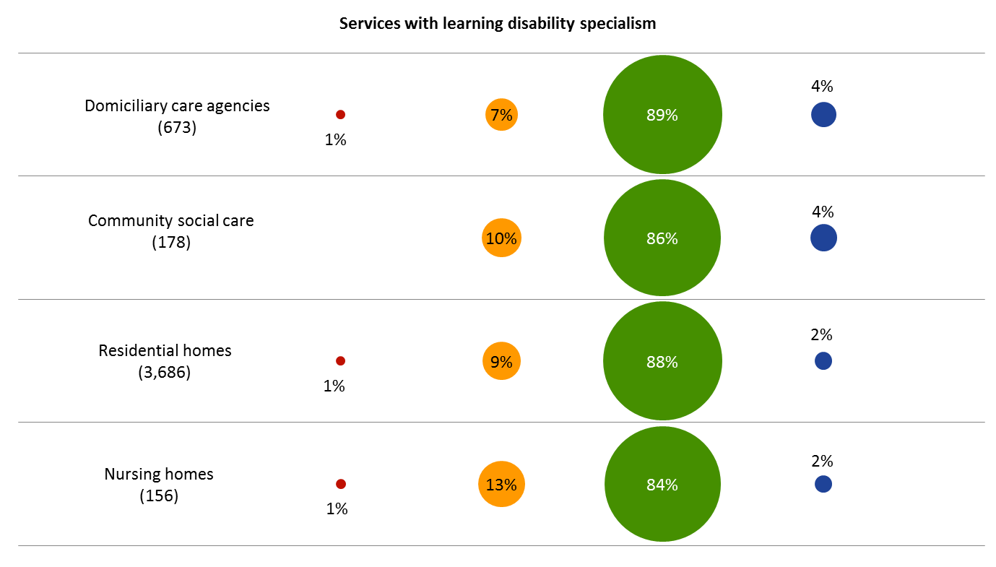
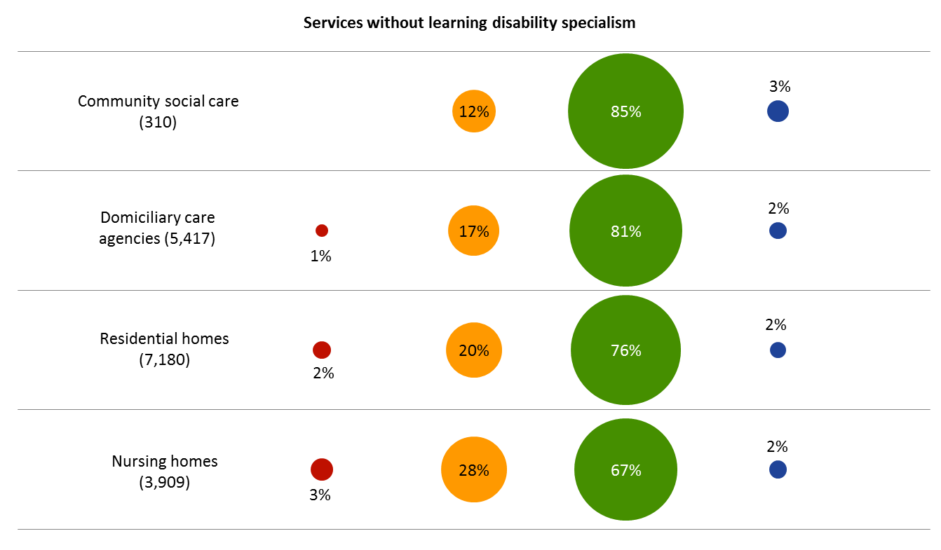
Current overall ratings by type of services with and without learning disability specialism
Source: CQC ratings data, data extracted 05/12/2017

Slide 8
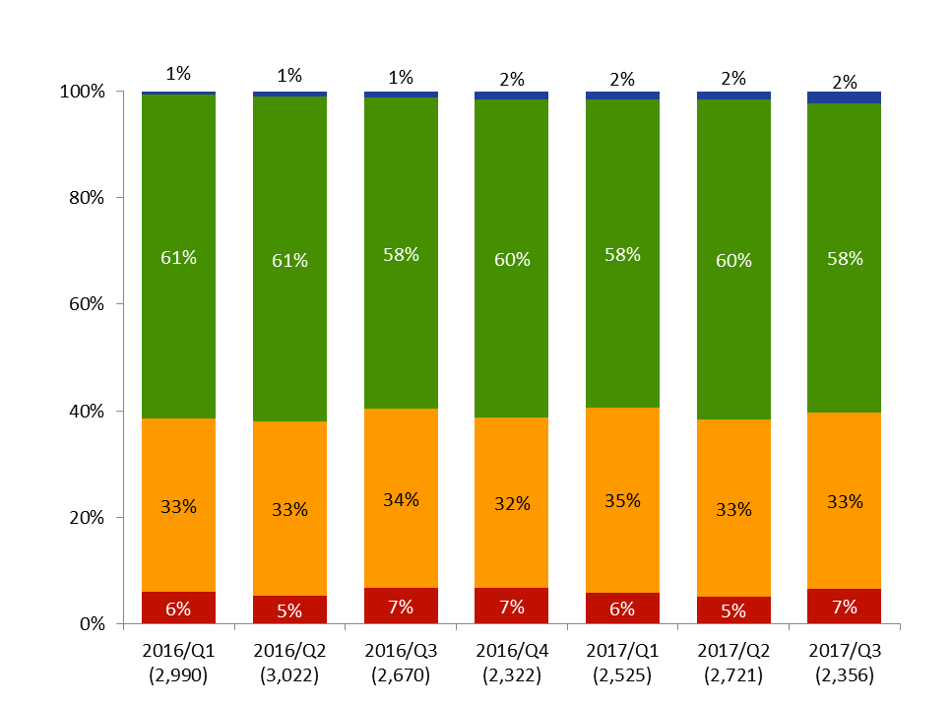
Overall ratings by publication quarter – Residential social care
Residential social care ratings, by publication quarter
Calendar quarter | Inadequate | Requires improvement | Good | Outstanding
2015 Q4 | 163 | 876 | 1,513 | 13
2016 Q1 | 176 | 978 | 1,818 | 18
2016 Q2 | 160 | 987 | 1,846 | 29
2016 Q3 | 181 | 896 | 1,561 | 32
2016 Q4 | 155 | 744 | 1,387 | 36
2017 Q1 | 148 | 876 | 1,461 | 40
2017 Q2 | 137 | 904 | 1,639 | 41
2017 Q3 | 156 | 780 | 1,367 | 53
Source: CQC ratings data, data extracted 05/12/2017. Completed quarters only.

Slide 9
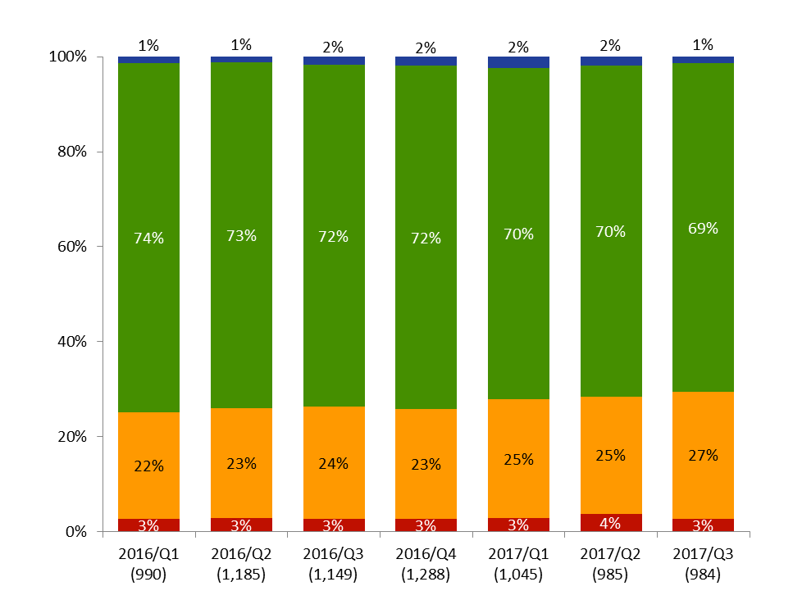
Overall ratings by publication quarter – Community social care
Community social care ratings, by publication quarter
Calendar quarter | Inadequate | Requires improvement | Good | Outstanding
2015 Q4 | 28 | 183 | 473 | 2
2016 Q1 | 27 | 222 | 728 | 13
2016 Q2 | 33 | 275 | 864 | 13
2016 Q3 | 30 | 272 | 828 | 19
2016 Q4 | 35 | 298 | 932 | 24
2017 Q1 | 30 | 261 | 729 | 25
2017 Q2 | 37 | 243 | 687 | 18
2017 Q3 | 27 | 263 | 680 | 14
Source: CQC ratings data, data extracted 05/12/2017

Slide 10
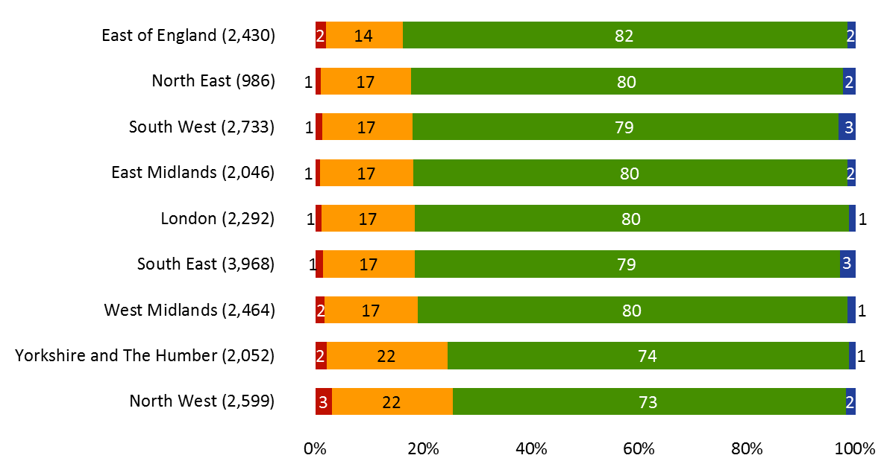
Overall ratings by region (rated locations)
Figures in chart are percentages of rated locations
Source: CQC ratings data, data extracted 05/12/2017

Slide 11
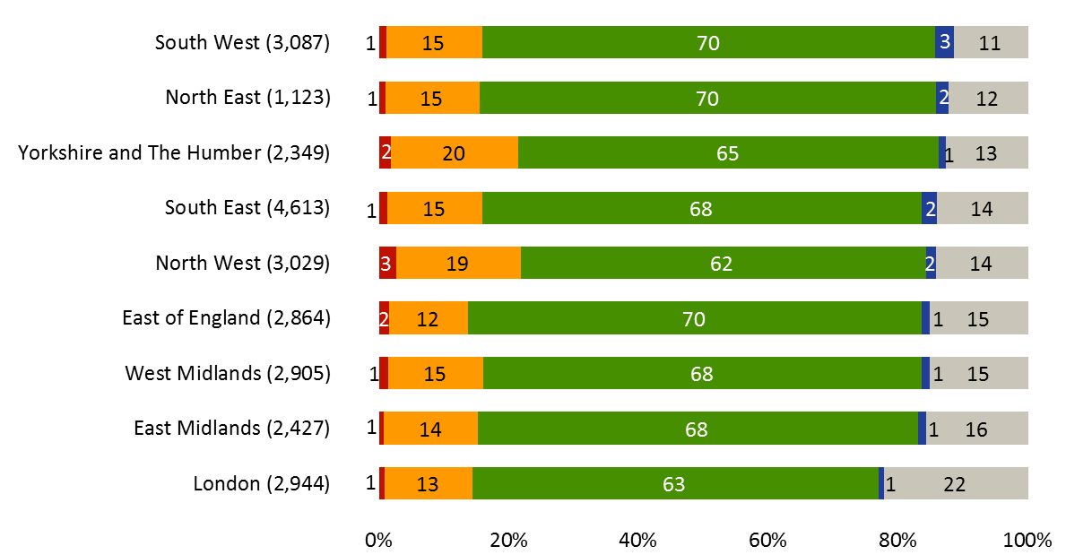
Overall ratings by region (all locations)
Figures in chart are percentages of all locations with the grey % being locations not yet rated
Source: CQC ratings data, data extracted 05/12/2017

Slide 12
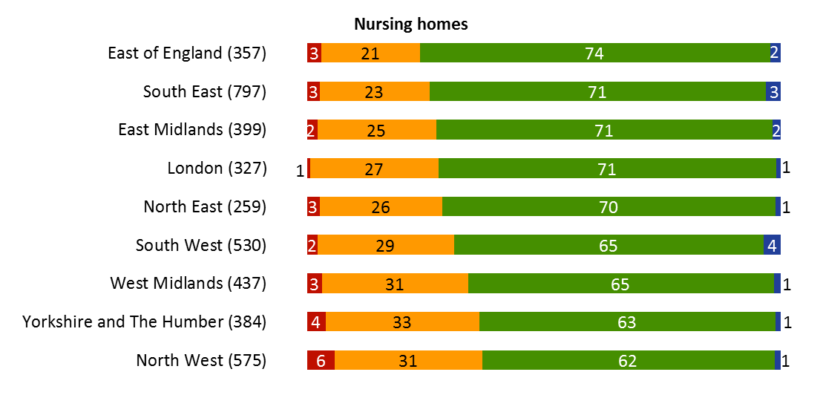
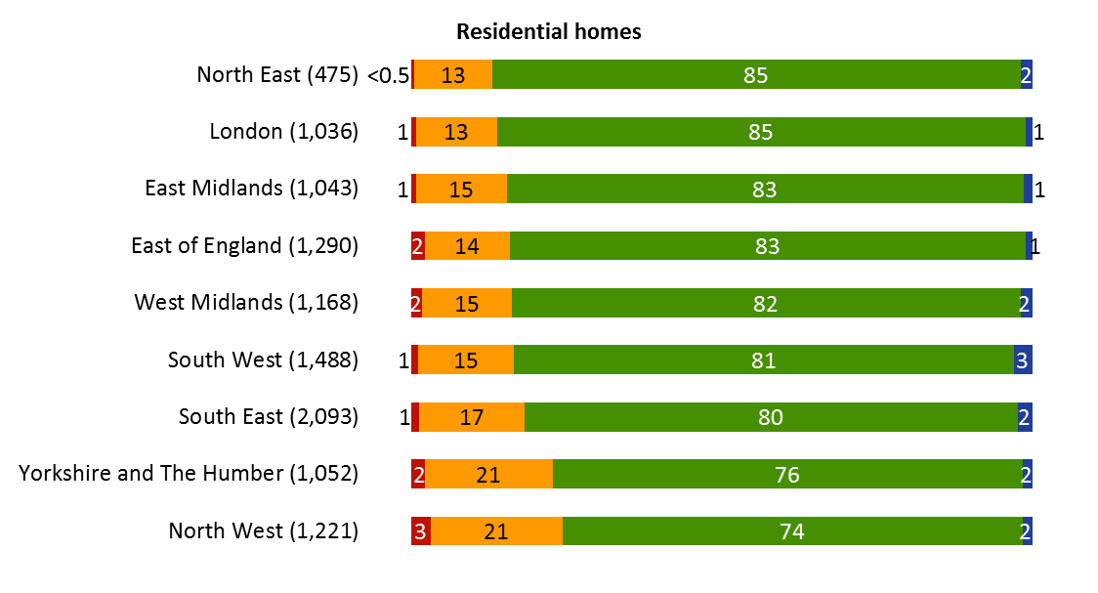
Nursing and Residential ratings by region
Figures in chart are percentages of rated locations
Source: CQC ratings data, data extracted 05/12/2017

